Slide 1
Discussion of Conditional Functional Dependencies
Erik Wang

Slide 2
In the next 20 minutes…
What is the challenge?
What inside CFDs?
How to use CFDs?
Future works on CFDs?
One final question to this discussion:
If you are a boss, will you invest in CFD?
If you are a scientist, will you research CFD?

Slide 3
Quick flash:
Q - What kind of data quality challenge do we have?

Slide 4
Inconsistent data
Q - How to deal with inconsistent data?
Apply dependencies, constrains…
Notes:
* Not talking about detail implementation, for a solution.
Have people do it manually

Slide 5
Inconsistent data
-Solution: by model the consistency
Nice to have some objective rules to validate data inconsistency
i.e. if data satisfies some conditions, then it determines consistent value for related column.
So this is Functional Dependency
A functional dependency defines that the data in the data object may be normalized.

Slide 6
Reality problems
In real world, heterogeneity always happen
ZIP codes in Canada indicate Street, but it doesn’t apply in America
Q: Other example?

Slide 7
REGION | TITLE | COUNTRY | LENGTHOFSERVICE | BASESALARY | VARIOUSBONUS
APJ | Engineer | JP | 5 | 4000 | 500
APJ | Manager | JP | 5 | 4000 | 500
APJ | Engineer | JP | 10 | 6000 | 1000
APJ | Manager | JP | 10 | 6000 | 1000
AMS | Engineer - I | CA | 5 | 4500 | 500
AMS | Manager – I | CA | 5 | 5500 | 800
AMS | Engineer – I | CA | 10 | 4500 | 1200
AMS | Manager – I | CA | 15 | 5500 | 1500
AMS | Engineer – II | CA | 5 | 6000 | 900
AMS | Manager – II | CA | 10 | 7000 | 1600
Q: What can we get from this relation?
Any FD exist?
Notes:
[COUNTRY] -> [REGION]

Slide 8
What Functional Dependency can’t do?
FD can’t handle specific conditions
FD doesn’t allow values, it cares table structure
If we put several “standards” into one relation, FD can only describe general column relations
Q – How to cope with these issues?
Notes:
t1[X] = t2[X] => t2[Y] = t1[Y]
Divide relation to groups and apply FD respectively
or
Extend FD is a good idea
Could we have a mechanism/tool can help us to refinement the circumstance?
Q - How to approach?

Slide 9
FD and CFD
A FD looks like
f1: [COUNTRY] → [REGION]
A CFD looks like
Cf1: ([COUNTRY, TITLE] → [BASESALARY], T1)
COUNTRY | TITLE | BASESALARY
CA | _ | _
CA | Engineer - I | 4500
CA | Engineer - II | 5500
CFDs are a form of constrained functional dependencies

Slide 10
“Boss” salary in the last 5 years
ID | Year | First Name | Job Title | Company | Region | Salary
1001 | 2013 | Tim | CEO | Apple | AMS | 4.17 M
1002 | 2012 | Peter | CFO | Apple | AMS | 68.6 M
1004 | 2013 | Larry | CEO | Google | AMS | 1
6001 | 2013 | Andrew | CEO | BHP Billiton | APJ | 1.7 M
6004 | 2012 | Akio | CEO | Toyoda | APJ | 1.86 M
8001 | 2012 | Stephen | CEO | Nokia | EMEA | 5.63 M
8003 | 2013 | Paul | CEO | Nestle | EMEA
… | … | … | … | … | … | …

Slide 11
CFDs prosperities
Q – What properties are expected of CFDs?
Inference system
Consistency, minimal covers of CFDs, etc.
Notes:
– minCover algorithm

Slide 12
How to use CFDs?
Q – How to apply CFDs to real database?
Translate CFDs into SQL query
Follow up Q – Why don’t we do this by SQL initially?

Slide 13
Understand SQL
Q – What could the SQL be?

Slide 14
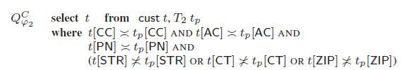

SQL examples:
Notes:
Qv gives only the X attribute of inconsistent tuples. Return is more concise than return whole tuple

Slide 15
Merge CFDs
Q – Method to merge CFDs
Involve new symbol @ to denote don’t care value.
Notes:
Put attributes together

Slide 16
Factor which impact detection result
Q - What index do we need to evaluate for CFD?
Detection time / SQL query execute time
Q - Which factors will affect test result?
Number of tuples (SZ)
Number of constants and variables
Number of attribute
Number of the tuples in CFDs
Notes:
Execute time
Number of tuples (SZ)
Number of constants and varibles
Number of attribute
Number of the tuples in CFDs

Slide 17
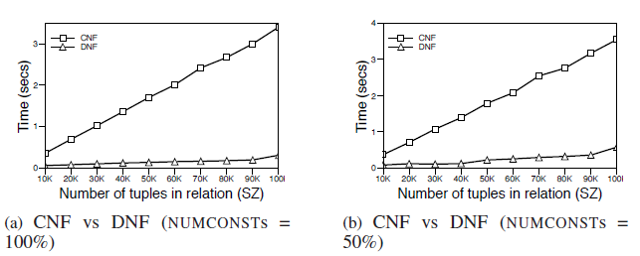
Experimental study
Notes:
DNF out-performs CNF
Conjunctive Normal Form (p1 or p2 or p3) and (q1 or q2 or q3)
Disjunctive Normal Form (p1 and p2 and p3) or (q1 and q2 and q3)
In DNF, each sub-query doesn’t impact to peers, thus optimizer can optimize each sub-query
If one sub-query will bring new constrain to another sub-query, use CNF
Change CNF to DNF leads exponential blow-up, but in this case number of attributes in the CFD is small

Slide 18
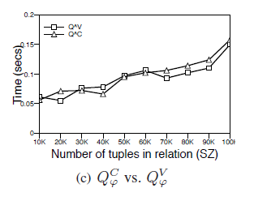
Notes:
Similar loads
Follow the same execution trend

Slide 19
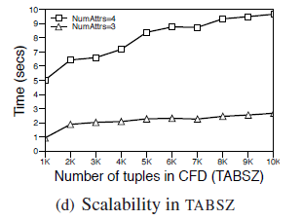
Notes:
Number of tuples in CFDs has little impact
Dominant factors are:
Size of the relation – if it much larger than tableaux
Number of attributes – add join complexity

Slide 20
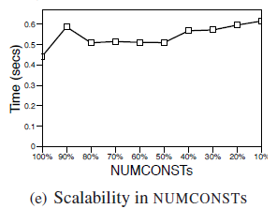
Notes:
More variables (columns) were involved

Slide 21
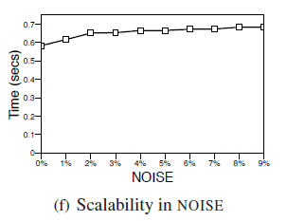
Notes:
Consume time of SQL executing is not changed

Slide 22
Contribution of this paper
Q - What are the contribution of this paper?
Formalize the definition
Inference system to help us make good use of CFD – computing minimal covers of CFDs
Generate SQL to find inconsistent tuples
Indentify impact factor of using CFDs

Slide 23
Prospect of CFDs
Q – Future works on CFDs?
How to indentify CFDs from relation?
Any other better implementation to products?

Slide 24
Let’s review the final question
If you are a boss, will you invest in CFD?
If you are a scientist, will you research CFD?

Slide 25
Thanks for your participant

Slide 26
Backup slides

Slide 27
Defining data quality how can CDF help?
Completeness
All the required values are electronically recorded
Las 5 dimensiones de la calidad de datos*:
Standards-based
Data conforms to industry standards
Consistency
Data values aligned across systems
Accuracy
Data values are right, at the right time
Time-stamped
Validity timeframe of data is clear
*Source: GCI/CapGemini Report: “Internal Data Alignment”, May 2004

Slide 28
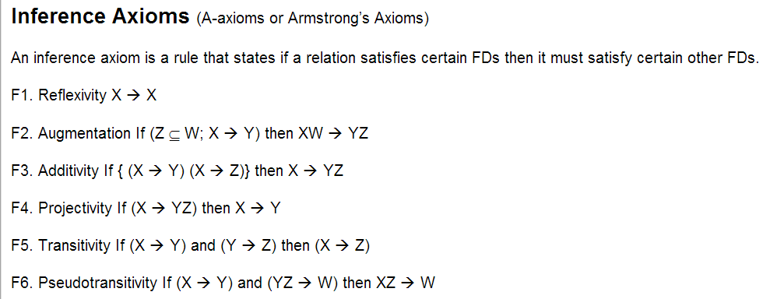
Armstrong axios

Slide 29
What functional dependency can do?
Determine particular value in one relation
FD will fulfill all the tuples in this relation
Help us to reduce error
orphan records are removed, domain value inaccuracies are corrected

